Slide 1
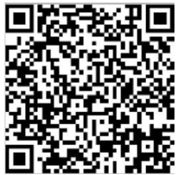
Attendance
May 1, 2025

Slide 2
Business Meeting
May 1, 2025
Notes:
5:00-5:05 (Dr. David Tom Cooke)
Call to Order
Confirm only voting TSDA Members are present
Confirm a quorum is present (51 PDs or their designated proxies)
Review Agenda:
Universal Offer Date
Revisions to the TSDA Bylaws
Service Recognition
Nominating Committee Member Election
Nominating Committee Report (to elect TSDA Officers)

Slide 3
Universal Offer Date for Independent Programs
Notes:
5:05-5:15 Universal Offer Date (action item) (Dr. David Tom Cooke)
Review Dr. Berfield’s report from before the break
Discuss the Recommendation and Call for a Motion, Second, and Discussion.
Conduct Voice Vote. (simple majority required)

Slide 4
Proposed TSDA Bylaws Revisions
Notes:
5:15-5:20 Approval of Proposed Revisions to the TSDA Bylaws (action item) (Dr. David Tom Cooke)
Reference that materials were distributed to the Program Directors on March 31 in accordance with the Bylaws
Discuss the Executive Committee’s Recommendation for approval:
updating TSDA’s mission, goals, and vision
standardizing the nomenclature of the TSDA In-Training Exam
clarifying membership categories, and
making small technical and grammatical corrections
Call for a Motion, Second, and Discussion.
Conduct Voice Vote. (2/3 majority required)

Slide 5
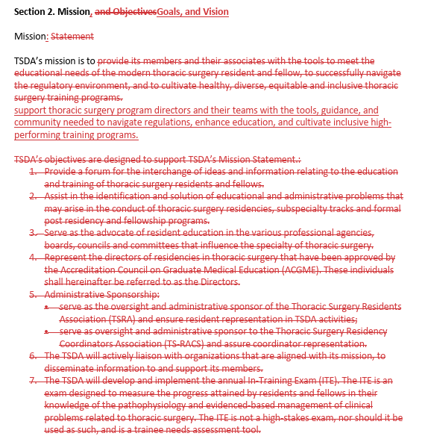

Slide 6
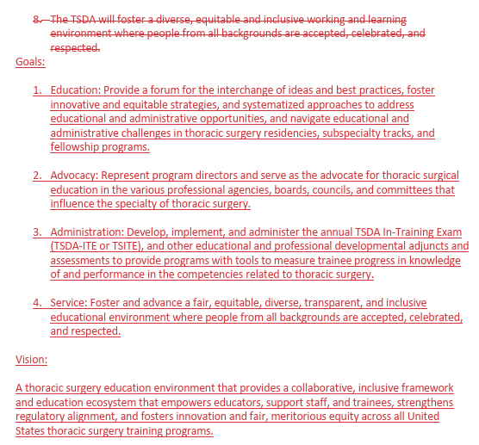

Slide 7
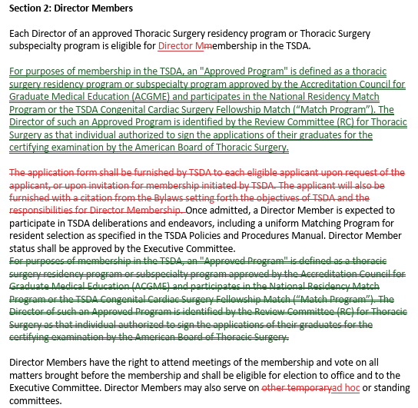

Slide 8
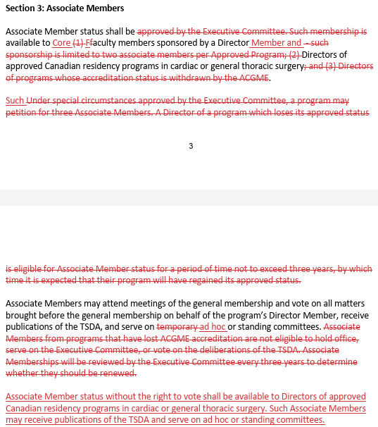

Slide 9
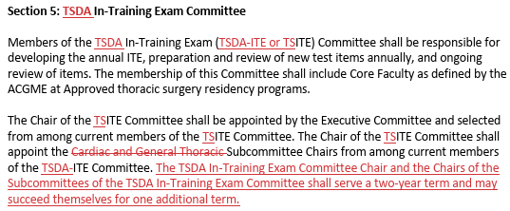

Slide 10
Proposed TSDA Bylaws Revisions
Notes:
5:15-5:20 Approval of Proposed Revisions to the TSDA Bylaws (action item) (Dr. David Tom Cooke)
Reference that materials were distributed to the Program Directors on March 31 in accordance with the Bylaws
Discuss the Executive Committee’s Recommendation for approval:
updating TSDA’s mission, goals, and vision
standardizing the nomenclature of the TSDA In-Training Exam
clarifying membership categories, and
making small technical and grammatical corrections
Call for a Motion, Second, and Discussion.
Conduct Voice Vote. (2/3 majority required)

Slide 11
Committee Service Recognition
Notes:
5:20-5:25 Committee Chair Introductions and Service Recognition (Dr. David Tom Cooke)
Note you will be recognizing the many individuals who have served TSDA in the past year.
Emphasize the Self-Nomination Process at the beginning of each calendar year that is open to Program Directors, Associate Program Directors, Core Faculty, and Program Coordinators. Many appointments are made based on self-nominations.
Advise everyone that appointment invitations for 2025-2026 roles will be sent later in May.

Slide 12
2024-25 Executive Committee
President | David Tom Cooke
President-elect | Stephen C. Yang
Secretary/Treasurer | Jonathan C. Nesbitt
Immediate Past President | A. J. Carpenter
Congenital Cardiac Surgery Fellowship Committee Chair | Richard D. Mainwaring
Early Specialization Committee Chair | Ahmet Kilic
Councilor | Cherie Erkmen
Councilor | Shari L. Meyerson
Councilor | Rita C. Milewski
Notes:
Recognize the committee members, noting that terms are ending for:
Jon Nesbitt
Ajay Carpenter
Ahmet Kilic
Shari Meyerson

Slide 13
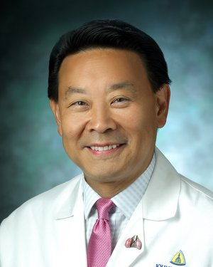
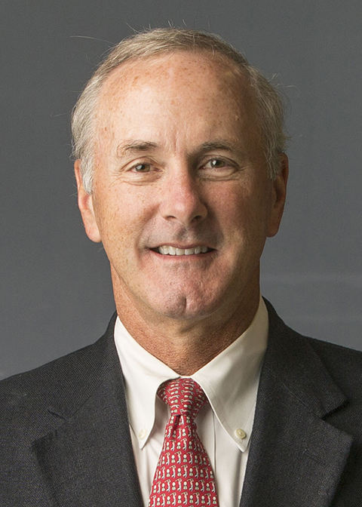
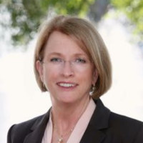
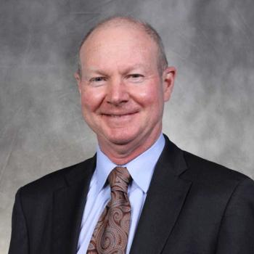
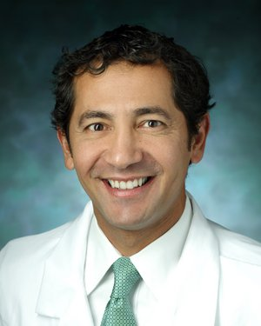
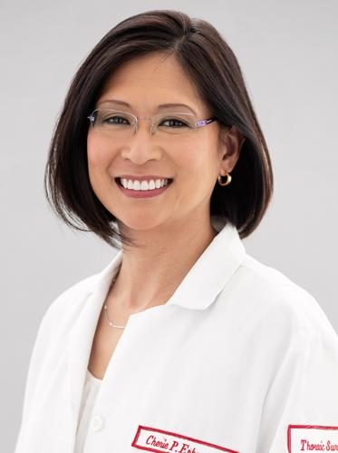
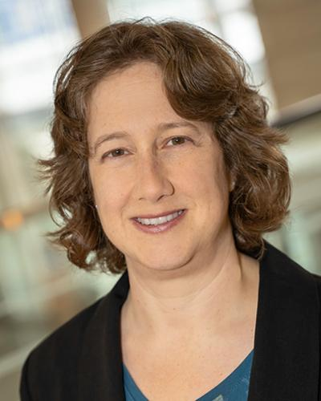
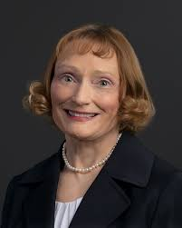
2024-25 Executive Committee
Notes:
Recognize the committee members, noting that terms are ending for:
Jon Nesbitt
Ajay Carpenter
Ahmet Kilic
Shari Meyerson

Slide 14
2024-25 Finance Committee
Secretary/Treasurer, Chair | Jonathan C. Nesbitt
 | Aditya Bansal
 | Thomas Fabian
 | Stephanie M. Fuller
 | Shari L. Meyerson
 | Rita C. Milewski
 | Stephen C. Yang
Notes:
Recognize the committee members.

Slide 15
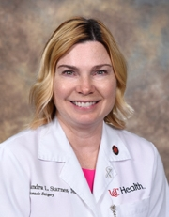
2024-25 Nominating Committee
Chair | Sandra L. Starnes
 | Andrea J. Carpenter
 | Nicole M. Geissen
 | Sara Pereira
 | Ara A. Vaporciyan
Notes:
Recognize the committee members, noting that the committee’s report will be delivered during the Business Meeting.

Slide 16
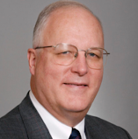
2024-25 Professionalism and Ethics Committee
Chair | John Mayer
Vice Chair | Emmanuel Daon
 | Marisa Cevasco
 | Deborah Kozik
 | Rita C. Milewski
 | Anthony Perez-Tamayo
Notes:
Recognize the committee members, noting that the committee only meets as needed and did not conduct any business in 2024-2025.

Slide 17
50th Anniversary Committee
Chair | Stephen C. Yang
Member | Andrea J. Carpenter
Member | Ara A. Vaporciyan
Chair | Stephen C. Yang
Member | Andrea J. Carpenter
Member | David Tom Cooke
Notes:
Recognize the committee members, noting that TSDA’s 50th Anniversary will occur in 2026.

Slide 18
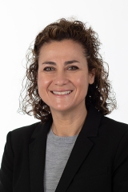
2024-25 Faculty Development Committee
Chair | Sara Pereira
Vice Chair | Kiran Lagisetty
 | DuyKhanh Ceppa
 | Caitlyn Demarest
 | Cherie Erkmen
Nicole M. Geissen
Amie Kent
Anthony LeMaire
Panos Vardas
Pyongsoo (David) Yoon
Notes:
Recognize the committee members.

Slide 19
2024-25 Early Specialization Committee
Chair | Ahmet Kilic
Vice Chair | Kirsten Freeman
 | Kathleen Berfield
 | Luis Godoy
 | Matthew Henn
 | Jeffrey Javidfar
 | Scott LeMaire
Sara Pereira
David Rabkin
Hai Salfity
Mansi Shah
Vikram Sood
Robert Sorabella
Nicholas Teman
Notes:
Recognize the committee members.
Note that Dr. Freeman will be succeeding Dr. Kilic as chair and will have a seat on the Executive Committee.

Slide 20
2024-25 Congenital Cardiac Fellowship Committee
Chair | Richard D. Mainwaring
(Program Directors of Congenital Fellowships)
Notes:
Recognize the committee members.
Membership is automatic based on Program Director appointments for each accredited Congenital Fellowship program.

Slide 21
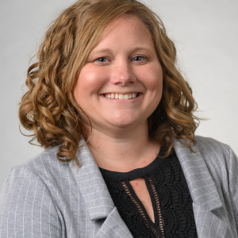
2024-25 Program Coordinator Committee
Chair | Carolyn Grissom
Vice Chair | Cynthia Gordon
 | Elizabeth Agraz-Sanchez
 | Amanda N. Bennett
 | Julie Boehm
 | Mari Collings
 | Carol Daunais-Kurpis
Patti Fluhrer
Katie Fuhs
Stephanie Kidd
Gretchen Lynch
April Rampersad
Hemali Shah
Notes:
Recognize the committee members.
Explain that this is a new committee and is intended to replace the TS-RACS group which dissolved during the COVID-19 Pandemic.

Slide 22
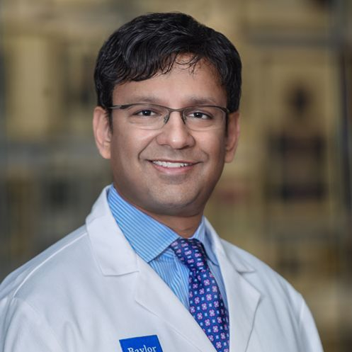
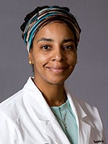
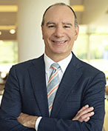
2024-25 TSDA In-Training Exam Committee
Chair | Ravi Ghanta
Congenital Subcommittee Chair | Richard D. Mainwaring
General Thoracic Subcommittee Chair | Aundrea Oliver
Cardiac Subcommittee Chair | Matthew Romano
Notes:
Recognize the committee members.
Note that Drs. Ghanta, Mainwaring, and Romano are completing terms in TSITE leadership.
Announce that Dr. Cherie Erkmen will be TSITE Chair in 2025-2026 with other subcommittee chairs appointed later in May.

Slide 23
2024-25 TSDA In-Training Exam Committee
Aaron M. Abarbanell
Muhammad Aftab
Mara B Antonoff
Claude Beatty
Castigliano Bhamidipati
James O’Brien
Marisa Cevasco
Pirooz Eghtesady
Abdul Elnaggar
Cherie Erkmen
Thomas Fabian
Nicole M. Geissen
Barry Gibney
Lyall Gorenstein
Joshua Hermsen
Jeremy Herrmann
Woodrow J Farrington II
Doraid Jarrar
Tara Karamlou
Toshinobu Kazui
Peter Kneuertz
Deborah Kozik
Kiran Lagisetty
Anthony Lemaire
Scott Lick
Vincent Mase
Constantine Mavroudis
Walter McGregor
David Rabkin
Gary Raff
Simran Randhawa
Mark Roeser
Gregory Rushing
Hai Salfity
Dean Schraufnagel
Alex B. Schutz
Rona Spector
Shelby Stewart
Matthew Stone
Monisha Sudarshan
Corinne Tan
Nicholas Teman
Frederick Tibayan
Panos Vardas
Jeffrey Velotta
Jack Wallen
Berhane Worku
Pyongsoo (David) Yoon
James Yun
Notes:
Recognize the committee members who wrote and reviewed questions for the 2025 TSITE and Congenital TSITE.

Slide 24
2024-25 Thoracic Education Cooperative Group (TECoG)
Kirsten Freeman, Chair
Mara Antonoff
Kathleen Berfield
Castigliano Bhamidipati
Amit Bhargava
Alicia Bonanno
Alejandro Bribriesco
Philip Carrott
David Cooke
Robert Dabal
Desmond D'Souza
Steven Eisenberg
Thomas Fabian
Dana Ferrari-Light
Amy Fiedler
Nicole Geissen
Scott Halbreiner
Matthew Henn
James Huang
Jessica Hudson
Doraid Jarrar
Lyle Joyce
Amie Kent
Min Kim
Kiran Lagisetty
Paul Linsky
Jessica Luc
Natalie Lui
Vincent Mase
Melissa Medina
Brian Mitzman
David Odell
Ikenna Okereke
Aundrea Oliver
Mark Orringer
Anthony Perez-Tamayo
Roman Petrov
Rishindra Reddy
Brett Reece
Scott Reznik
Gregory Rushing
Dean Schraufnagel
Matthew Schuchert
Aleem Siddique
Praveen Sridhar
Shelby Stewart
Monisha Sudarshan
Ibrahim Sultan
Frederick Tibayan
Betty Tong
Simon Turner
Ara Vaporciyan
Elliot Wakeam
John Waters
Daniel Wiener
Jennifer Wilson
Moritz Wyler von Ballmoos
Pyongsoo (David) Yoon
Notes:
Recognize the committee members.

Slide 25
Nominating Committee Member Election
Notes:
5:25-5:30 Nominating Committee Member Election (action item) (Dr. David Tom Cooke)
“The TSDA Bylaws stipulates that one member of the Nominating Committee be elected by the Directors. Through the Self-Nomination Process, one candidate self-nominated to serve a one-year term as Elected Member of the Nominating Committee: Dr. Rita Milewski (Yale University).”

Slide 26
2025-26 Nominating Committee Member Election
Candidate: Rita C. Milewski
Notes:
“Are there any nominations from the floor?”
[If none.] “Those voting in favor of the election of Dr. Milewski as member of the Nominating Committee in 2025-2026, say “aye”. [pause] Those opposed, say “nay.””
[Announce the vote.]
[If a majority is not secured, seek nominations from the floor. Ask the nominee if they accept the nomination. If so, proceed with voting until a Nominating Committee Member from among the Program Directors is elected.]
“Congratulations, Rita!”

Slide 27
Report of the Nominating Committee
Notes:
5:30-5:40 Nominating Committee Report: TSDA Officer Elections (action item) (Dr. Ara Vaporciyan)
David: Introduce Ara (if not present, introduce Dr. Sara Pereira).
Ara: “Dr. Cooke, the Nominating Committee is responsible for presenting the TSDA nominees for offices which are or have become vacant: President-elect, Secretary/Treasurer, and Councilor.”
For the position of Secretary/Treasurer, the committee nominates Dr. Ahmet Kilic (Program Director at Johns Hopkins) for a four-year term.

Slide 28
2025-29 Secretary/Treasurer
Nominee: Ahmet Kilic
Notes:
Those voting in favor of the election of Dr. Kilic, say “aye”. [pause] Those opposed, say “nay.”
[Announce the vote.]
If a majority is not secured, seek nominations from the floor. Ask the nominee if they accept the nomination. If so, proceed with voting until a Secretary/Treasurer from among the Program Directors is elected.]
“Congratulations, Ahmet!”

Slide 29
Report of the Nominating Committee
Notes:
For the position of Councilor, the committee nominates Dr. Ravindranath Ghanta (Program Director at Texas Heart Institute/Baylor College of Medicine) for a three-year term.

Slide 30
2025-28 Councilor
Nominee: Ravi Ghanta
Notes:
Those voting in favor of the election of Dr. Ghanta, say “aye”. [pause] Those opposed, say “nay.”
[Announce the vote.]
If a majority is not secured, seek nominations from the floor. Ask the nominee if they accept the nomination. If so, proceed with voting until a Councilorfrom among the Program Directors is elected.]
“Congratulations, Ravi!”

Slide 31
Report of the Nominating Committee
Notes:
For the position of President-elect, the committee nominates Dr. Shari Meyerson (Program Director at University of Kentucky) for a two-year term.

Slide 32
2025-27 President-elect
Nominee: Shari L. Meyerson
Notes:
Those voting in favor of the election of Dr. Meyerson, say “aye”. [pause] Those opposed, say “nay.”
[Announce the vote.]
If a majority is not secured, seek nominations from the floor. Ask the nominee if they accept the nomination. If so, proceed with voting until a President-elect from among the Program Directors is elected.]

Slide 33
2027-2029 President Shari L. Meyerson
Notes:
“Congratulations, Shari!”
Invite Shari to say a few words if she wishes.

Slide 34
Report of the Nominating Committee
Notes:
“With these elections, Dr. David Cooke automatically becomes TSDA’s Immediate Past President and Dr. Stephen Yang becomes TSDA’s President.”
“Drs. Cooke and Yang, this concludes the Report of the Nominating Committee.”

Slide 35
2025-2027 26th President Stephen C. Yang
Notes:
David: “Congratulations, Steve”
[David, you may say a few words about Steve and invite him to preside as the new President and saying a few words.]
[Steve, you may say a few words.]

Slide 36
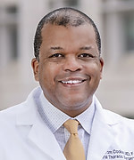
2023-2025 25th President David Tom Cooke
Notes:
[Steve, you are now presiding and may say a few words about David and present a plaque.
Move on to Other Business.]

Slide 37
Business Meeting
May 1, 2025
Notes:
5:40-5:50 Other Business (Dr. Stephen Yang)
Ask if there is any old business.
Ask if there is any new business.
5:50-6:00 Closing Remarks (Dr. Stephen Yang)
You may give closing remarks.
Please ask everyone to complete the evaluation.

Slide 38
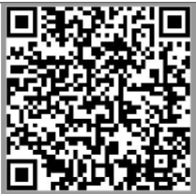
Evaluation
Spring General Session
Notes:
Please ask everyone to complete the evaluation.
Announce that the next meeting will be in-person in conjunction with the 2026 STS Annual Meeting.
Adjourn the meeting.

