Slide 1
Universal Offer Date
Independent Thoracic Fellowship Recruitment 2025-2026
Universal Offer Date Task Force
Kathleen Berfield, MD
Notes:
In an effort to improve transparency, predictability, and decrease the overall stress associated with the recruitment season for our applicants the TSDA on behalf of the Independent Thoracic surgery residency program directors has recommended Universal Offer Date for the 2025-2026 recruitment cycle.

Slide 2
Universal Offer Date Background
Independent Thoracic Surgery Fellowship programs will release interview offers on the same date.
Transparency
Predictability
Decrease anxiety and stress for applicants
Consistent with National Recommendations
Consistent with other surgical specialties recruitment practices
Orthopedics- subspecialities, General Surgery subspecialities: Advanced GI MIS, HPB, Bariatrics, Foregut, Hernia and Abdominal Wall, Breast Oncology
Coalition of Physician Accountability (COPA)
Association of American Medical Colleges (AAMC)
Organization of Program Director Associations (OPDA)
Notes:
The adoption of a Universal offer date is in keeping with national recommendations by the Coalition for Physician Accountability, the Association of American Medical Colleges and the Organization for Program Director Associations and has already been adopted by many other surgical and procedural specialties

Slide 3
Benefits of a Universal Offer Date
Creates structure and predictability for the recruitment process similar to the I-6 process
Less disruptive for applicants
Allows programs time for holistic review of applications
Improves efficiency of interview scheduling
Provides protected time for applicants to review interview invitations and plan their interview season
Notes:
UOD will have many benefits for both applicants and programs. Specifically, it creates a common timeline for the interview invitation process which provides structure and predictability for both applicants and programs.
This will be less disruptive for applicants on busy clinical rotations/ night float rotations
It also importantly provides programs protected time for holistic review of residency applications

Slide 4
Program Commitment:
Only offer as many invites as interview spots
Guarantee an interview if applicant responds by deadline
Honor system
Publicly report participation in UOD on program website/social media
Notes:
The Integrated thoracic surgery residency programs will commit to:
Offer only as many interview invitations as spots available
Guarantee an interview if the applicant responds by the deadline
Publicly report participation in the Universal Offer Date either on their website, social media or in communication with applicants

Slide 5
Applicant Commitment:
Respond before the 48 hour deadline
Do not hold interview spots applicant does not plan on attending
Review all invitations and thoughtfully plan acceptances
Notes:
Central to the success of this process is a mutual commitment by applicants and programs.
Applicants should commit to:
Review all interview invitations and thoughtfully plan acceptances
Respond before the 48 hour deadline
Do not hold interview spots they do not realistically plan on attending

Slide 6
What have we learned from the I-6 UOD?
Programs can set preferences to allow immediate or delayed scheduling in Thalamus
No moratorium on communication between the program and applicants is better for all parties
UOD on a weekday to remove pressure on program administrators from feeling obligated to answer questions over the weekend

Slide 7
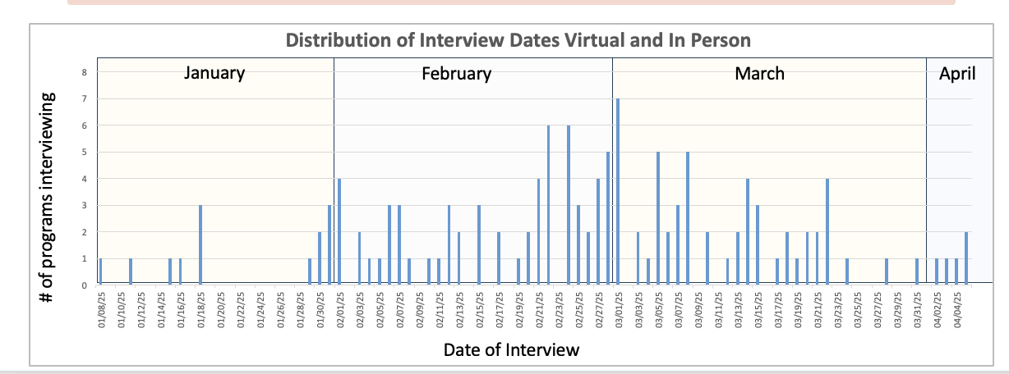
Current State
79 ACGME Accredited Independent Thoracic Surgery Fellowships
67 programs offered Interviews this year
Notes:
Majority of Interviews took place in Feb and March
January Interviews: 13 total, 10 V / 3 IP
February Interviews: 26 V (14 after Feb 17 ( / 32 IP (19 after Feb 17)
Interview data not available for 3 programs
48 programs sent invites out before Jan 20th this year.
Of those, 22 programs offered virtual interviews ( 2 offered one V and IP interview date).
Of the 26 programs that offered in person interviews, all offered IP interviews on at least 2 dates in Jan/Feb/Mar

Slide 8
Fellowship timeline considerations
ERAS Applications are available for review by programs on December 3, 2025
Anticipate Rank List will be due at end of April like this year.
29 programs also have Integrated Thoracic Surgery residency programs
21 programs share a Program Director
Hanukkah and 2 additional Federal Holidays in December / January
Rising number of applicants, ~ 157 applicants per year

Slide 9
Universal Offer Date Timeline: 2025-2026 Cycle
Tuesday, January 20, 2026
All programs extend interview offers
48 Hours
Applicants have up to 48 hours to respond to the invitation before the program can release the invitation to another applicant
Thursday, January 22, 2026
If programs have not heard from an applicant by the close of business on this date programs can send additional invitations to fill unfilled spots at their discretion
Notes:
Based on the experiences of other surgical programs The timeline for Universal offer date is as follows:
Programs will extend initial interview offers to applicants on Tuesday, January 20th in their usual fashion
This date was chosen because it was felt that it would provide ample time for application review
Applicants should respond to interview invitations with an acceptance or declination by close of business on, Thursday January 22nd .
If programs have unfilled spots for interviews after this first round of scheduling they can then start sending out additional interview invitations after the 48 hour period.
Time line allows for institutions with both / all pathways to
Central to the success of this process is a mutual commitment by applicants and programs.
48 programs sent invites out before Jan 20th this year.
Of those, 22 programs offered virtual interviews ( 2 offered one V and IP interview date).
Of the 26 programs that offered in person interviews, all offered IP interviews on at least 2 dates in Jan/Feb/Mar

Slide 10
UOD Task Force
Kathleen Berfield, MD
Ahmet Kilic, ND
Rita Milewski, MD
Sara Pereira, MD

