Slide 1
Thoracic Surgery Review Committee Update
Chris Fox, PhD, Executive Director
Review Committee for Thoracic Surgery

Slide 2
RC Membership
Name | Role | Name | Role
Mark Iannettoni, MD, MBA, FACS, FCCP* | Chair | Sandra Starnes, MD, FACS, FCCP | Vice-Chair
Akshitha Alvarez, MD* | Resident Member | Thomas Beaver, MD MPH | Member
James Jaggers, MD, FACS | Member | K. Robert Shen, MD, FACS, FCCP | Member
Mark Swofford, PhD, MHA, FACHE | Public Member | Stephen Yang, MD, FACS, FCCP | Member
Cameron Wright, MD | Ex-Officio, ABTS | Patrice Blair, DrPH, MPH | Ex-Officio, ACS
*Term Ends June 30, 2025
New Members, July 1, 2025: Sara Pereira, MD,Member; Chi Chi Do-Nguyen, DO, Resident Member

Slide 3
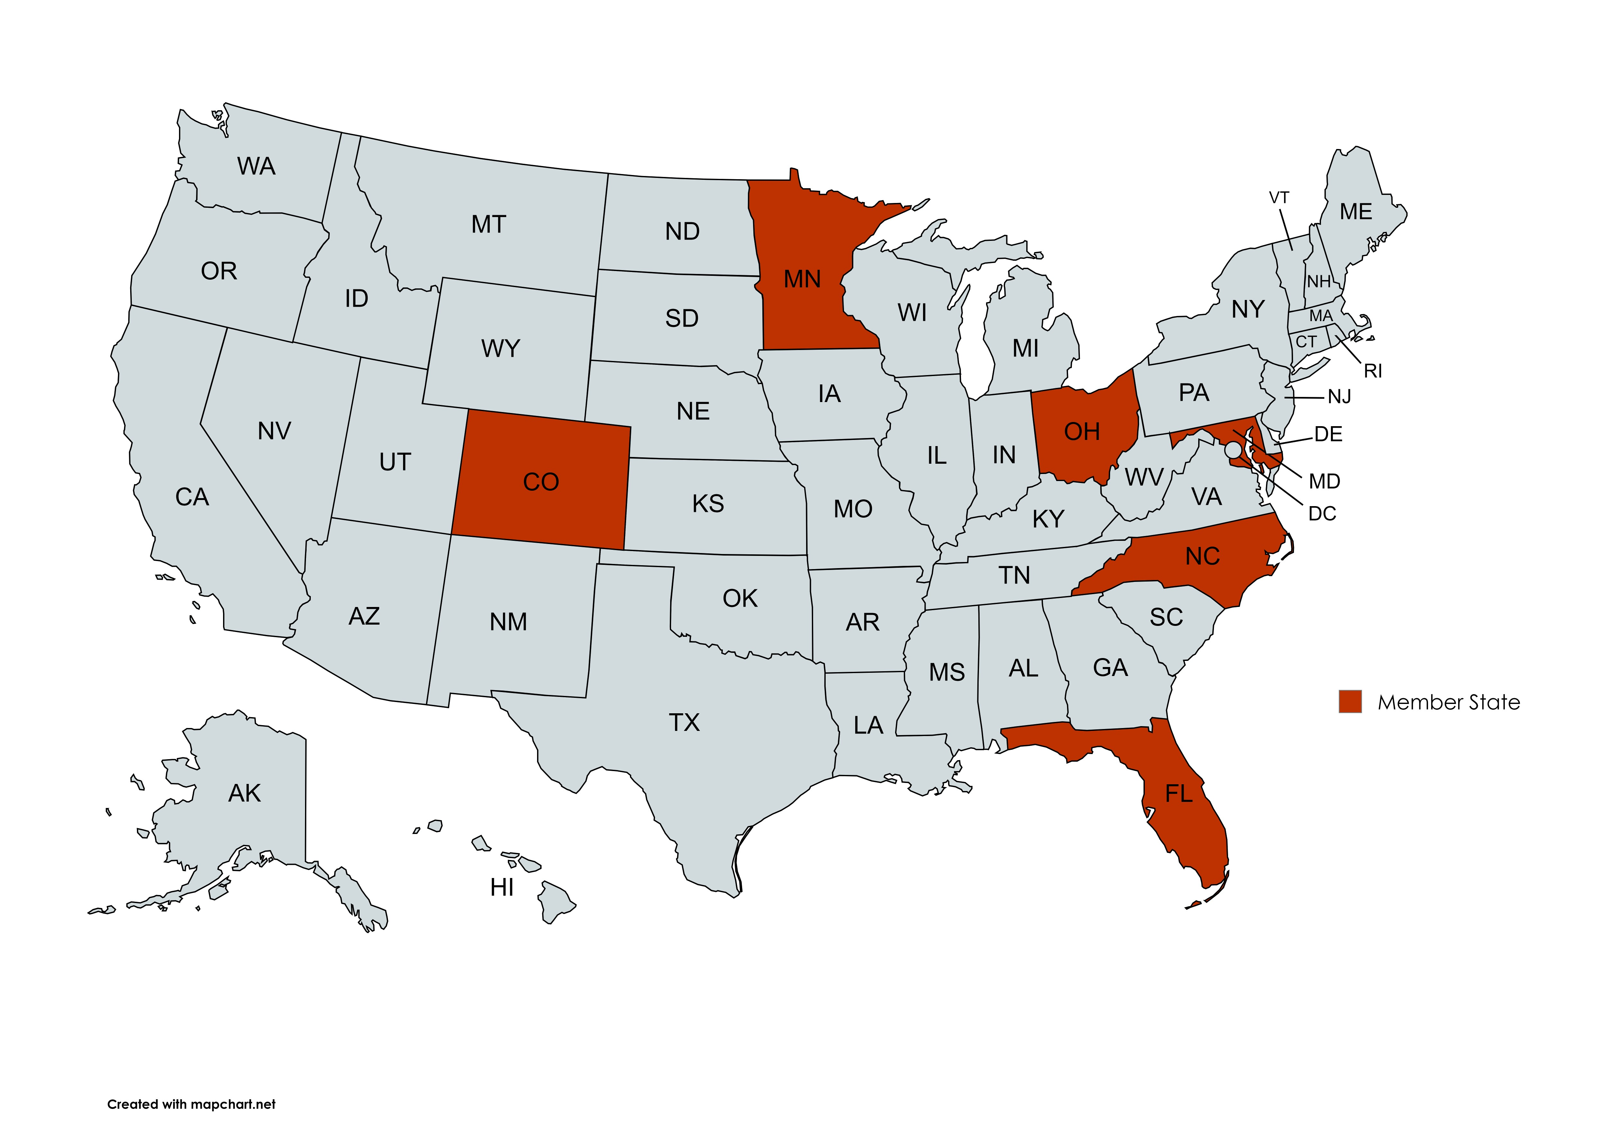

Slide 4
Program Info
Specialty | Accredited Programs | Applications (04/28/25) | Complement Approved (24-25) | Complement Filled (24-25)
Thoracic Surgery
Independent | 79 | 0 | 327 | 256
Integrated | 36 | 0 | 342 | 265
Congenital Cardiac Surgery | 17 | 0 | 17 | 11

Slide 5
Program Status
Specialty | Initial Accreditation | Continued Accreditation | Continued Accreditation with Warning | Probation/ Withdrawal
Thoracic Surgery
Independent | 5 (6%) | 71 (90%) | 2 (3%) | 1 (1%)
Integrated | 3 (8%) | 31 (86%) | 1 (3%) | 1 (3%)
Congenital Cardiac Surgery | 2 (12%) | 15 (88%)

Slide 6
Citations - Independent

Slide 7
Citations - Integrated

Slide 8
3 Pathways

Slide 9
Pathways
Review Committee will issue an automatic citation for missed minimums
ENSURE CORRECT PATHWAY IS SELECTED

Slide 10
Program Director Changes
II.A.3.d) must include documented experience educating thoracic surgery residents/fellows; (Core)
II.A.3.e) must include documented participation in a national thoracic surgery educational association (e.g., the Thoracic Surgery Directors Association); and, (Core)
II.A.3.f) must include documented formal faculty development activities in education and teaching, such as participation at local and national program director workshops and other educational activities. (Core)

Slide 11
Program Director Changes
Specialty-Specific Background and Intent:
The Review Committee feels that the training of thoracic surgery residents/fellows is a complex undertaking and the accreditation requirements are extensive. Individuals pursuing a program director role must be sufficiently prepared to take on the role and have the support of the department and Sponsoring Institution to devote the time and effort required to oversee a high-quality thoracic surgery program. Therefore, the Review Committee suggests that new program director candidates should have a minimum of five years’ experience as a faculty member in graduate medical education and some experience as an associate program director or other residency/fellowship program leadership experience. A letter of support outlining the Sponsoring Institution’s plan for mentoring and providing appropriate resources should accompany requests for approval of program director candidates who do not have the minimum requisite experience.

Slide 12
APD FTE
II.A.2.c) Program directors who oversee both an integrated and an independent thoracic surgery program which, combined, have 10 or more residents/fellows must appoint an associate (or assistant) program director. (Core)
II.A.2.d) The associate (assistant) program director must be provided with support equal to a dedicated minimum of 10 percent FTE for administration of the program. (Core)
Q? Can the FTE be shared?
A: YES

Slide 13
Block Diagram
The Review Committee for Surgery is creating a standardized block diagram form.
Fillable excel
Will be available on the Documents and Resources page in the 2025-26 academic year

Slide 14
Common Program Requirements (CPRs)
Work has started on Revision of CPRs
First Congress will center around ‘Work Hours’
Public comment will be solicited
Feedback from groups such as TSDA and ABTS requested
Timeline is Summer/early Fall

Slide 15
Meet the Surgery Team
Kelsey Sill, MHA
Associate Executive Director
Caleb Mitchell
Senior Accreditation Administrator
Chris Fox, PhD
Executive Director
Aimee Morales
Associate Executive Director
Colleen Morris
Accreditation Administrator

Slide 16
Thank You!
Questions?

