Slide 1
2025 TSDA In-Training Exam Chair: Ravi Ghanta, MD Cardiac Chair: Matthew Romano, MD Thoracic Chair: Aundrea Oliver, MD Congenital Chair: Richard Manwaring, MD

Slide 2
TSDA ITE Purpose
Give trainees an assessment of their knowledge strengths and gaps
Inform Program Directors
Knowledge base of individual trainees
Identify strengths and weaknesses of the program

Slide 3
2025 TSDA In-Training Exam Saturday, February 8, 2025 Make-up date on February 15, 2025
New This Year:
3 answers
160 Multiple Choice Questions
80 Cardiac
80 Thoracic
Clinical scenario (Stem).
What is the next best step?
Mediastinoscopy
Mitral Valve
Immunotherapy

Slide 4
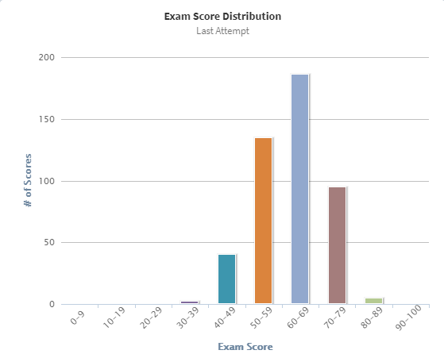
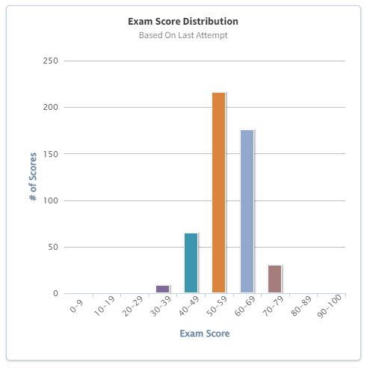
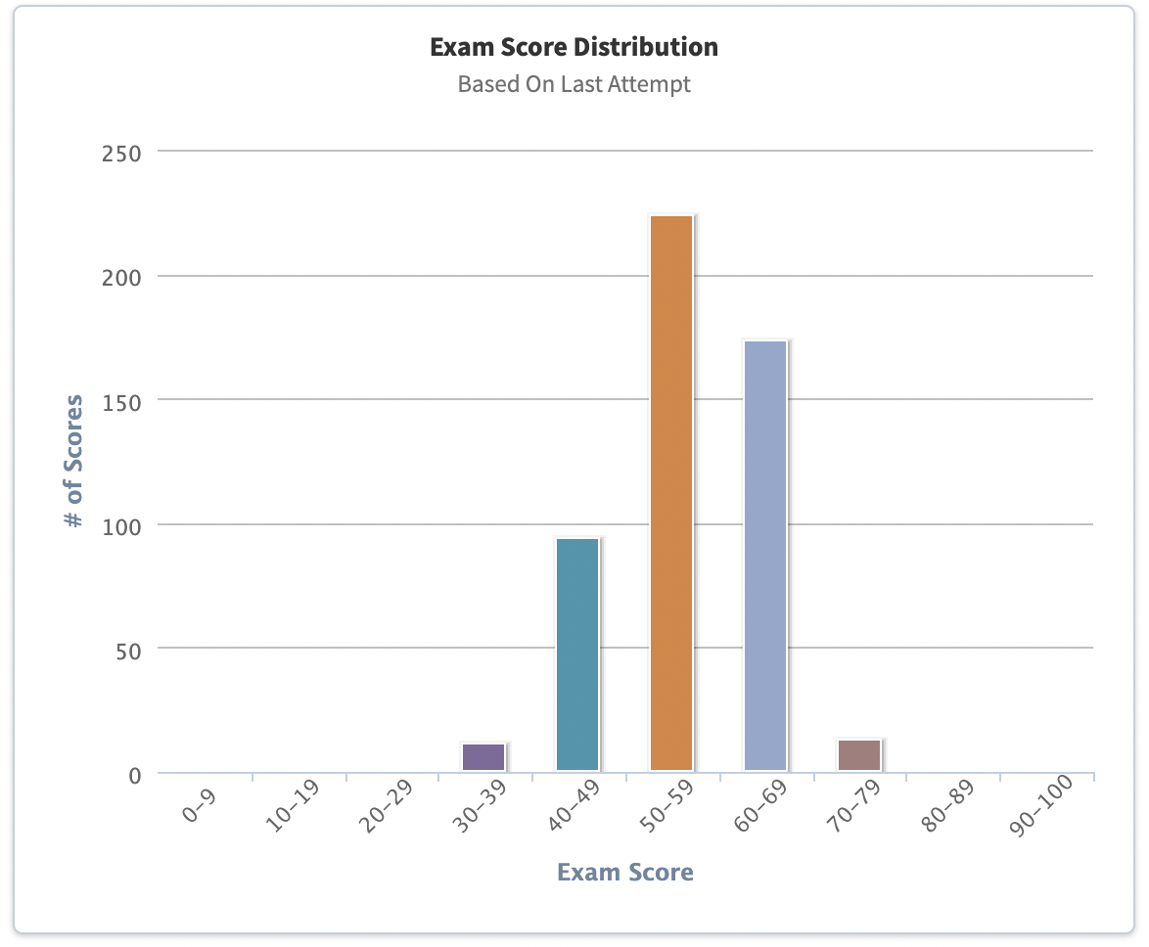
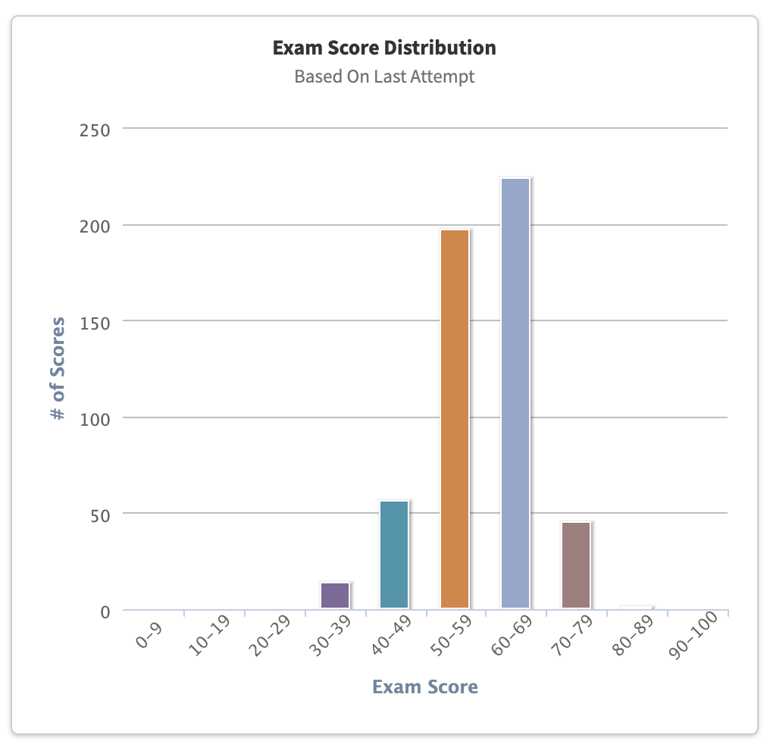
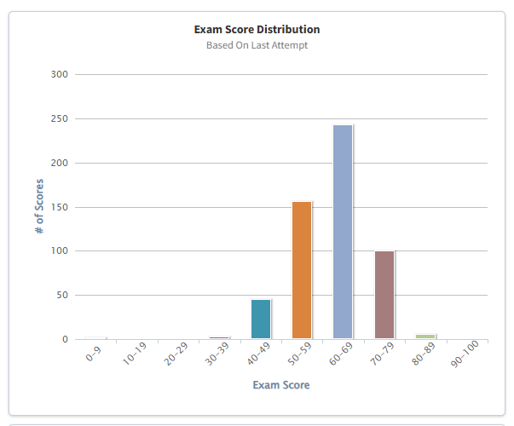
Exam Performance
2021
460 examinees
average grade is 62.6 %.
Average time is 3.5 hours.
2022
492 examinees
average grade is 58.3 %.
Average time is 3.5 hours.
2023
515 examinees
Average grade is 56.4 %.
Average time is 3.6 hours.
2024
538 examinees
Average grade is 58.9 %.
Average time is 3.7 hours. .
2025
567 examinees
Average grade is 62.2 %.
Average time is 3.4 hours. .

Slide 5
Your Report
https://exams.tsda.org

Slide 6
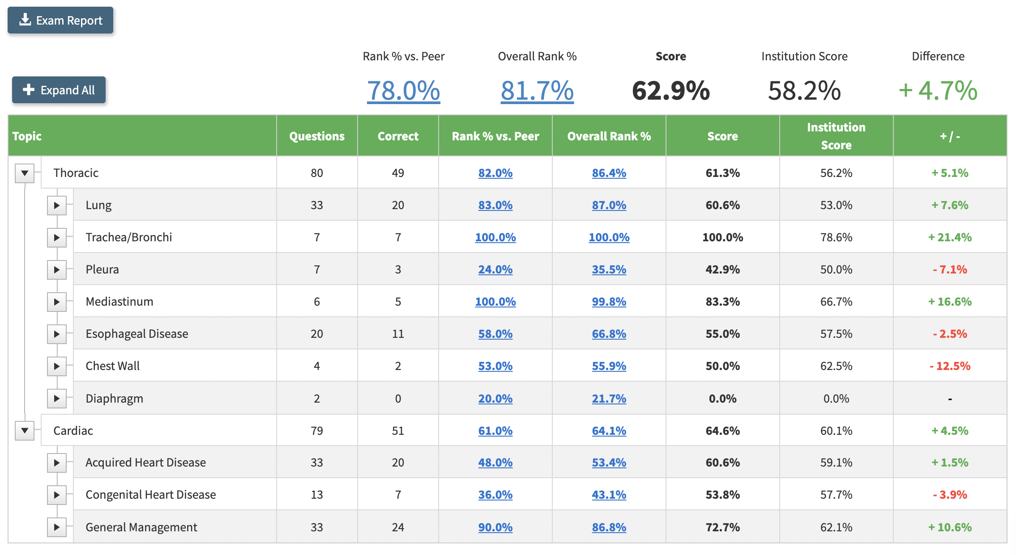
Your Report
https://exams.tsda.org

Slide 7
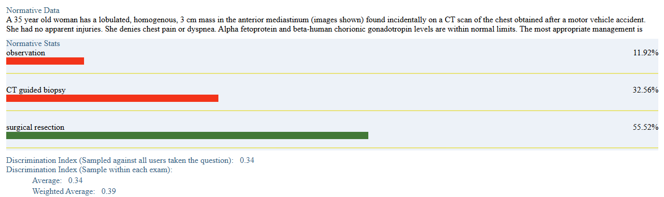
2025 TSDA In-Training Exam
Each question has a minimum of
Author with referenced content
Reviewer
Cardiac/Thoracic Committee Chair Review
Assessment Specialist Review
ITE Chair Review
66% of questions have all the above and
at least 1 year of performance metrics
https://exams.tsda.org

Slide 8
2025 TSDA In-Training Exam
ITE Committee Members Earn CME
Aundrea Oliver,
Thoracic Subcommittee Chair
Mara Antonoff
Cherie Erkmen
Thomas Fabian
Nicole Geissen
Barry Gibney
Lyall Gorenstein
Doraid Jarrar
Peter Kneuertz
Kiran Lagisetty
Vincent Mase
Simran Randhawa
Hai Salfity
Dean Schraufnagel
Rona Spector
Shelby Stewart
Monisha Sudarshan
Jeffrey Velotta
Matthew Romano, Cardiac Subcommittee Chair
Muhammad Aftab
Castigliano Bhamidipati
Marisa Cevasco
Abdul Elnaggar
Woodrow Farrington II
Toshinobu Kazui
Anthony Lemaire
Scott Lick
Walter McGregor
David Rabkin
Gary Raff
Gregory Rushing
Alex Schutz
Corinne Tan
Nicholas Teman
Frederick Tibayan
Panos Vardas
Berhane Worku
Pyongsoo (David) Yoon
James Yun
Richard Mainwaring, Congenital Subcommittee Chair
Aaron Abarbanell
Claude Beatty
Pirooz Eghtesady
Joshua Hermsen
Jeremy Herrmann
Tara Karamlou
Deborah Kozik
Constantine Mavroudis
James O’Brien
Mark Roeser
Matthew Stone
Jack Wallen
Feedback to Committee Members
(Eligible for Recommendation to ABTS)
https://exams.tsda.org

Slide 9
Poll
Do your trainees use their day off to take the exam?
(no other clinical duties)
Are hours taking the In-Training Exam considered work hours?
3. The In-Training Exam and the back up exam are both on Saturdays. Would it be helpful to have a back up exam on a weekday?
https://exams.tsda.org

Slide 10
Questions? Suggestions?
https://exams.tsda.org

Slide 11
Take-Home Message: Consistent, evidence-based assessment of CT Surgery trainee knowledge Thank You
https://exams.tsda.org

