Slide 1
General Session
May 1, 2025

Slide 2
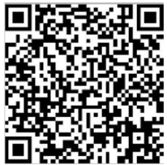
Attendance
May 1, 2025

Slide 3
Agenda
Welcome
Reports and Updates
Panel Discussion
Universal Offer Date
Break (Meet Your Mentor)
Business Meeting

Slide 4
General Session
May 1, 2025

